Slide 1


Deferred payment platform
Abigaela Popescu

Slide 2
The problem
6% (2.5million) unable to afford their utility bills ^{[1]}
11% (4.6million) cannot afford to adequately heat their home ^{[1]}
18% (12million) estimated to be living within the Absolute Poverty Rate ^{[2]}
89% exceed their monthly budget by overspending – 29% of those shop outside their means ^{[3]}
More and more people are struggling to lead a good quality of life in the UK. However, this should not force people to live a monotone life. Individuals should have opportunities to enjoy leisure activities and afford enriching experiences and non-essential materialistic goods.
A deferred payment platform will benefit every debit/ credit card holder, regardless of social status, current financial situation or credit history.
Notes:
References:
[¹] https://ifs.org.uk/publications/living-standards-poverty-and-inequality-uk-2024
[²] https://commonslibrary.parliament.uk/research-briefings/sn07096/
[³] https://www.aquacard.co.uk/building-better-credit/brits-social-spending-habits

Slide 3
The aim
The objectives
To research a market in which the project could be launched in (i.e. clothing retailers, groceries, gaming, etc.) and record findings in a document
To research current ethical and technical issues of Buy Now Pay Later Plan (BNPL) platforms and record findings in the form of a report
Brainstorm application features and values and record ideas onto a mindmap
Create web application framework (MVP) of the Deferred Payment Platform on Figma and collect user feedback
Develop web application using CSS, HTML, Node.js on Visual Studio Code
Write Final Report on the project in a Word document
15/11
We aim to make life more affordable, whilst educating our customers to make financially responsible choices.
25/11
03/12
31/12
03/03/25
15/03/25

Slide 4

Resources and assistive technology
Human Resources
Legal advisor
Financial consultant
Academic advisor
Cybersecurity specialist
Pilot users
Financial Resources
Development Costs – energy consumption, hired expertise, software licenses
Domain Certificate
Legal fees
Funding (grants, crowdfunding, investors, etc.)
Development/ Testing/ Hosting - Azure Microsoft
Technological Resources
Integrated Development Environment (IDE) - Visual Studio Code
Version Control System and Planning – GitHub
Programming Languages - Node.js (Javascript), CSS, HTML
Database – MySQL/ Azure SQL Database
Frontend Framework - React
User Feedback Collection – Google Forms
Deployment – Microsoft Azure
Hardware – i7 Personal Computer 16GB RAM + Peripherals
Prototype Software – Figma
APIs/ Third-Party Integrations - Plaid
Physical Resources
Personal Computer
External Monitor
Computer Peripherals
Mobile Testing - Mobile Device(s)
Ethernet Cable/ Wi-fi Router
Note-taking – Stationery, Paper/ Notebook/ Whiteboard

Slide 5
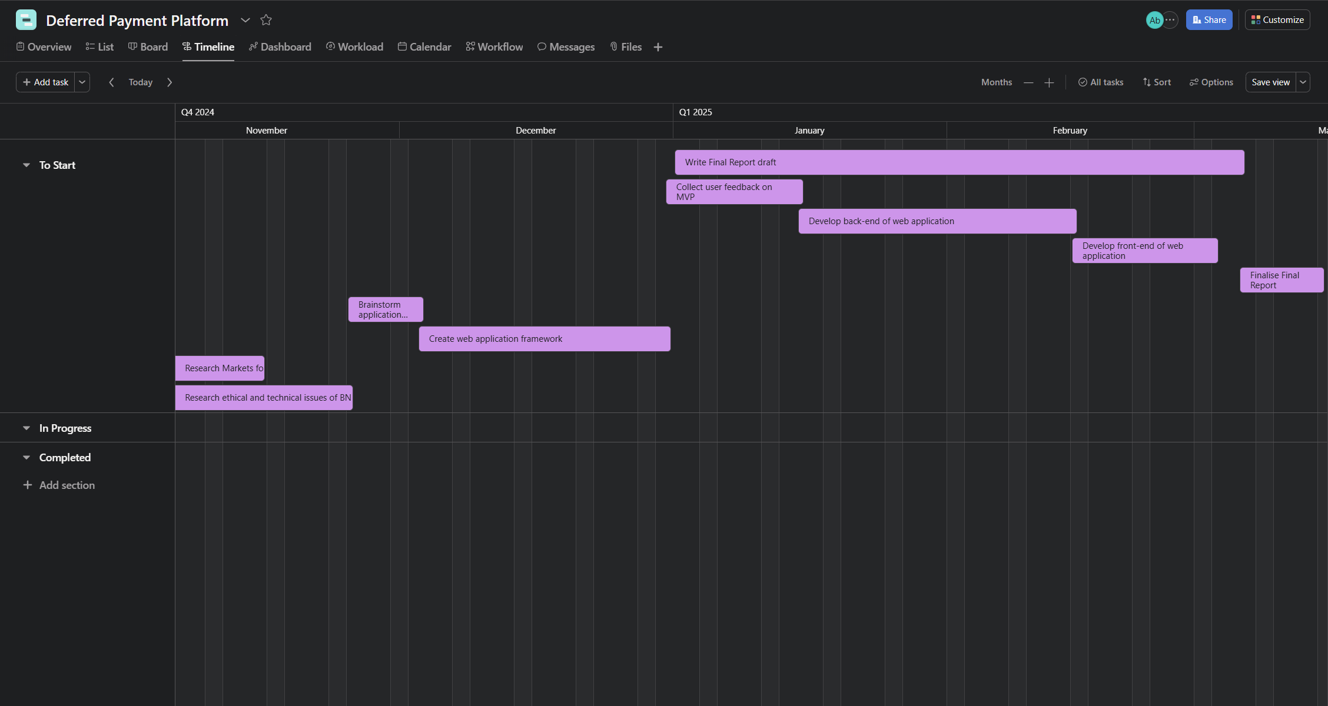
PROject timeline

